Slide 1
TELECOM CHURN PROJECT
BY:- SHAIFALI SHRIVASTAV
GCP DS-C5 DEC 2023

Slide 2
UNDERSTANDING THE BUSINESS PROBLEM
In the telecom Industry , Customers according to the law are able to choose from Multiple Service Providers available in the Market .
As it is a highly competitive market , since there are many players available and offering various Plans to suit the Customer’s needs and demands in the market , it becomes Extremely necessary for the Companies to take the decisions which are Data Driven and Market Trends .
On an Average Telecom Industry experience churn of the customers 15-20% annually .
This churn is very difficult for the operators in the market as it costs 5-10% more to the companies than to retain the existing ones and maintain them and meet their demands .
Looking at the above scenario it is extremely important for the companies to Retain their original Customers and not losing them and try to retain them .
Therefore , for the incumbent operators , their primary goal is to retain the existing customers rather than acquiring the new customers .
To reduce the churn of the customers , companies need to Predict that which all highly profitable customers are at the risk of churning .
There are basically two types of churn – A) Postpaid and B) Prepaid .
Predicting the Prepaid users churn is more difficult than the Postpaid ones since in Prepaid companies cannot decide as to the customers have stopped using the services or they have churned to the different companies .

Slide 3
The data set of the company which we have been provided is of 4 months .
From the above four months data , The Business objective is to predict the churn in the last month , using the features available to us from the first three months and depict it accordingly to the company .
To make the predictions , we need to understand the behaviour of the Churn of the customers according to the different months data provided to us . There are 4 months , so first month is “GOOD PHASE” , which states that Customers are happy and behaves well .
Second phase is “ACTION PHASE’ , which is of the next 2 months , i.e. , 2nd and 3rd month . In this phase , the customers gets a good and compelling offer from the other service providers or the competitors , or they are being uncharged fairly , or they are unhappy with the quality service , etc. In this phase customers generally shows different behaviour than the Good Phase . Since this is the crucial phase for the company it is very important for the company to retain the High Churn Risk customers and to match the needs and demands of the customers like matching the competitor’s offers , offering them good quality service , offering them discounts , etc .
Last phase is “CHURN PHASE” , where customers churn to the other companies . This is of the last month where maximum amount of the Churn takes place since the customers are not happy .
The last month’s data is what we have to prepare , where the Churn rates would be defined as well as the churn would be available based on the past month’s data.

Slide 4
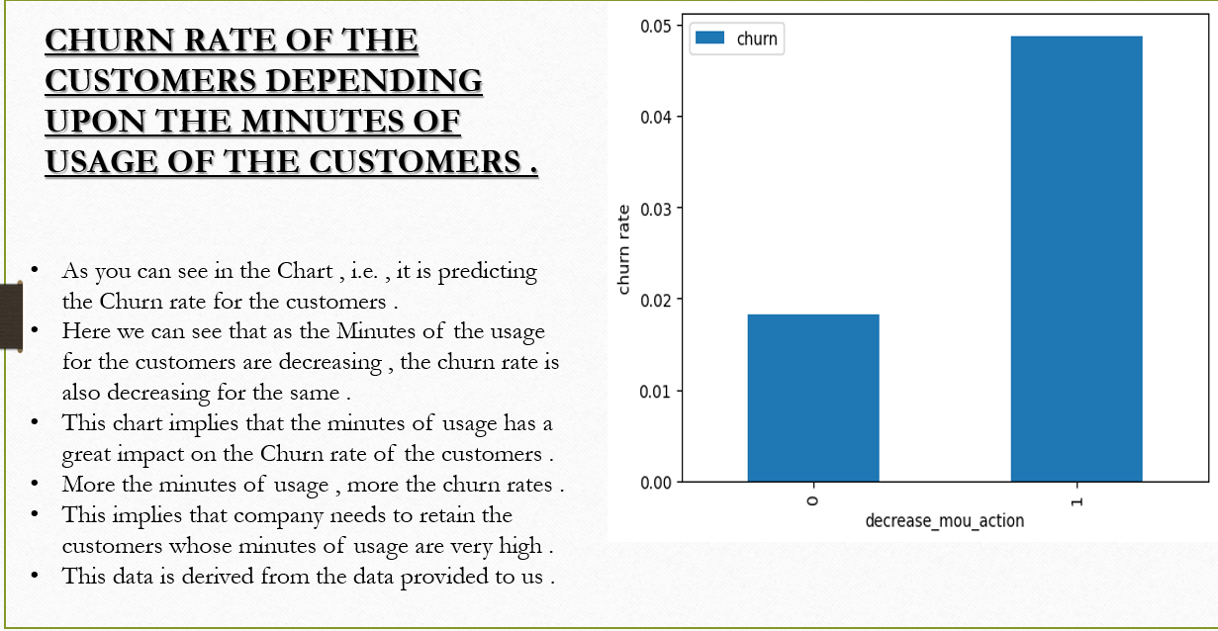

Slide 5
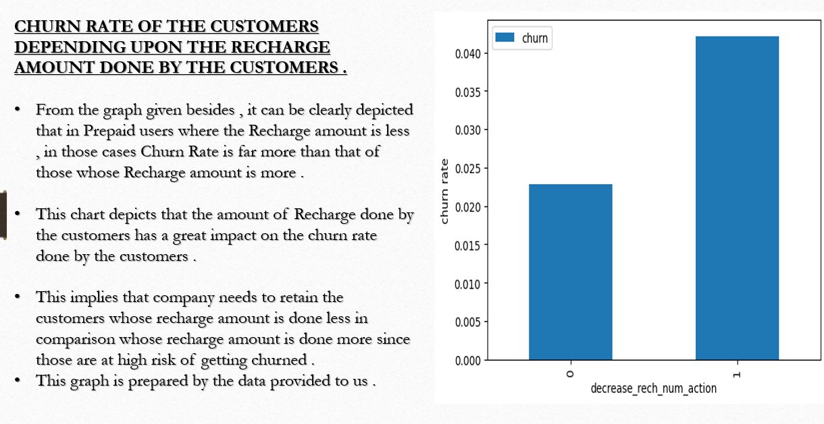

Slide 6
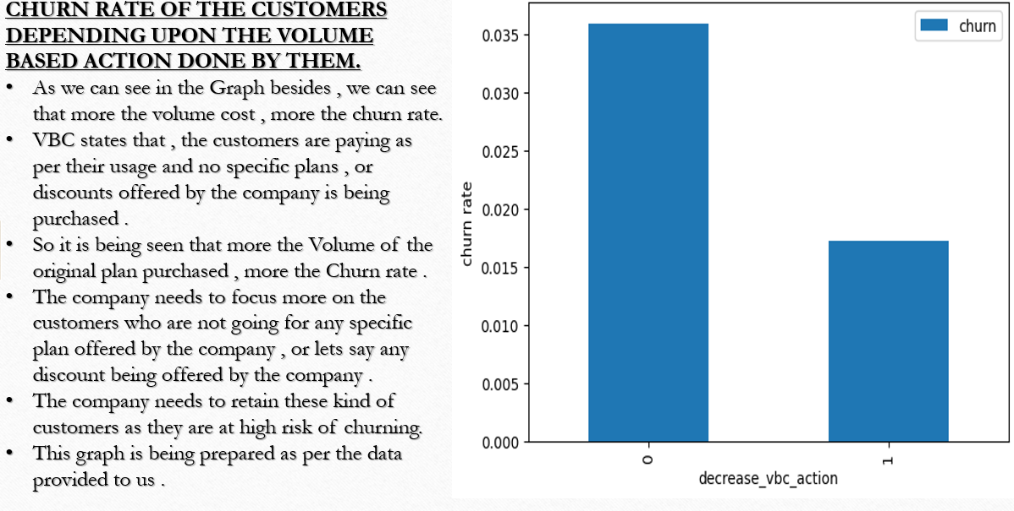

Slide 7
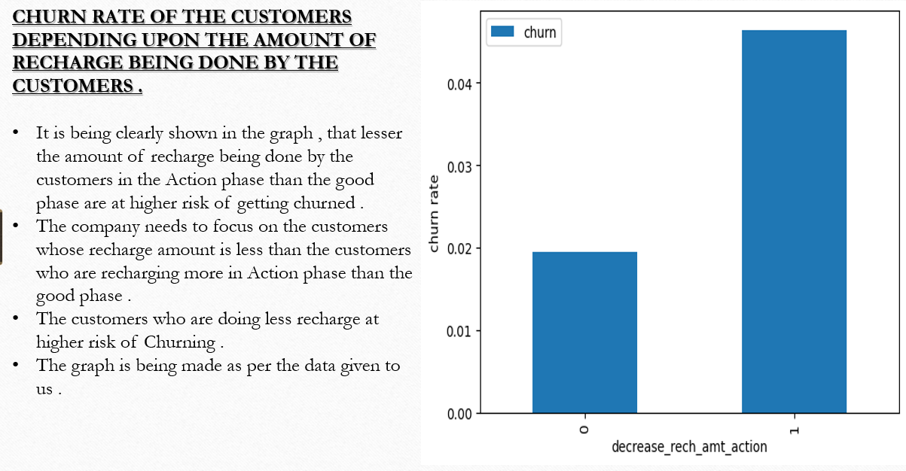

Slide 8
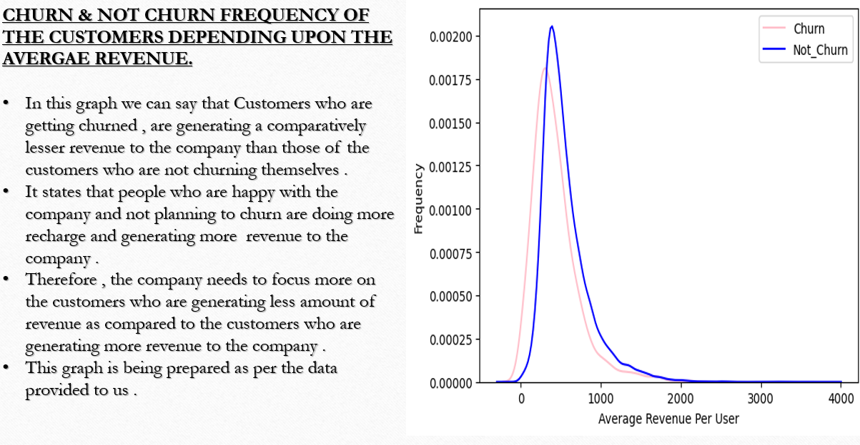

Slide 9
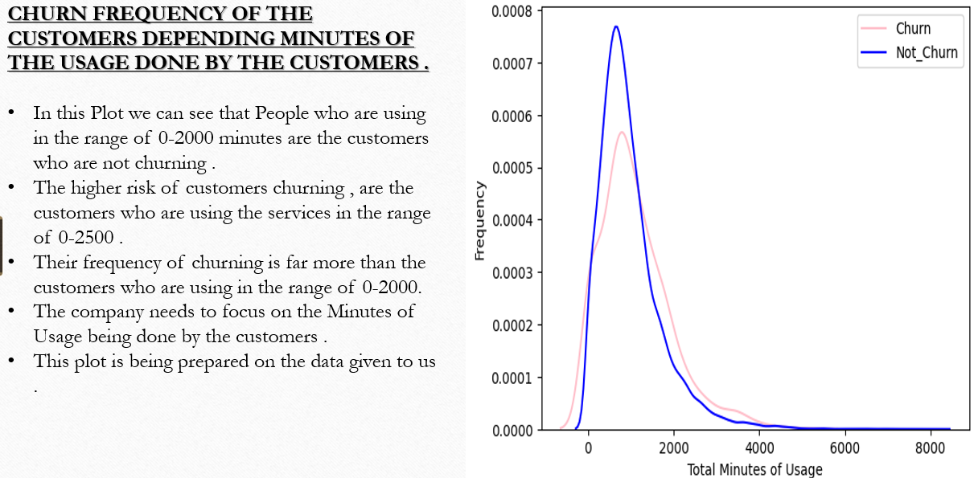

Slide 10
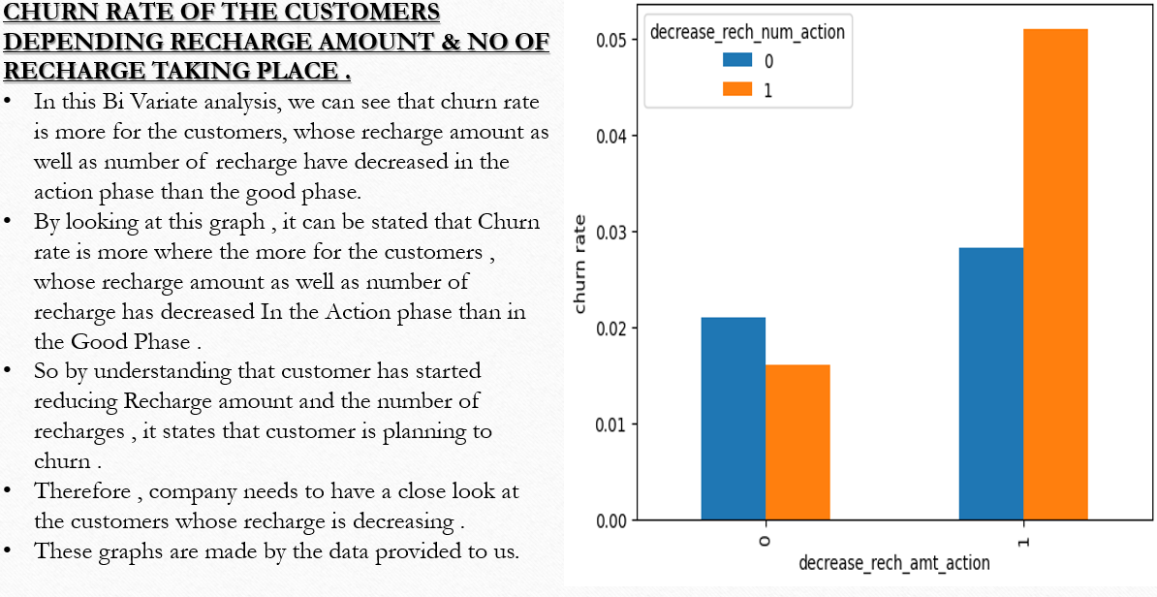

Slide 11
